Slide 1


Welcome to Year 2
Thursday 5th September 2024

Slide 2
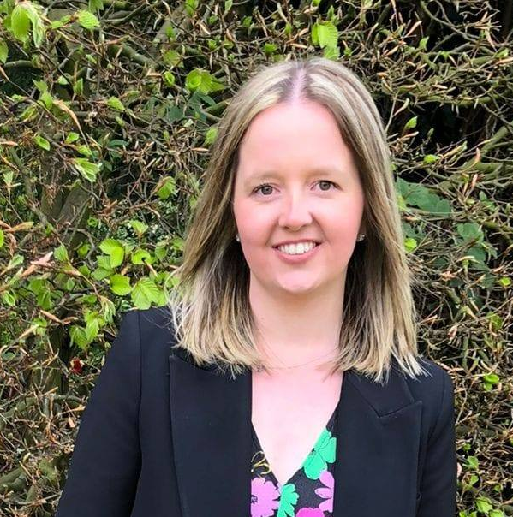
Meet the Year 2 Team
Miss Fowell – Class Teacher
Mrs Bould –
Teaching Assistant (Wed, Thur,Fri)
Mrs Morgan–
Teaching assistant (Mon, Tue)
Mrs Wadley –
Midday Supervisor

Slide 3
School Vision and Values
‘Learning and Growing Together’
Is underpinned by our school’s core values of Hope, Friendship, Forgiveness, Perseverance,
Respect, and Honesty.
We nurture the tiny seeds (that are each individual child and our community) to grow into the mighty tree, as Jesus describes the Kingdom of Heaven (Parable of the Mustard Seed- Matthew 13)
Individuals flourish in a school which is a safe, respectful and welcoming Christian community.
Learning-
We develop our wisdom, knowledge and skills
Growing-
In our character development, hope, aspiration, resilience and social action
Together-
So our community can live well together, showing dignity and respect.
Our Core School Values are Honesty, Hope, Forgiveness, Friendship, Perseverance and Respect. They permeate through school life and we ensure that our pupils live by these values in the way they conduct themselves in school, their behaviours in school and outside school.
These School Values are linked to the school code of conduct.

Slide 4
Beginning and end of the school day
Doors open at 8.45am.
Doors close at 8.55 am
Register is 8.55-9am
All pupils finish at 3.15pm
At the start of the day you will bring your child onto the playground and wait with them to be let into the classroom
At the end of the day please wait outside your child’s classroom ready for your child to be dismissed. Please can I ask that you do not peer in the class as this can be very distracting for the children.

Slide 5
School day
Door opens at 8.45 and closes at 8.55 and the register begins between 8.55am-9am.
If you are late please go to the School Office where Miss Simons will mark you into school. Please note that late arrival does go on to the register and onto your child’s records.
Please ensure your child is punctual as learning starts at 9am.
If your child is ill please call the school office before 9am to let us know.

Slide 6
Break time and Lunchtime
Break time;
In Infants fruit/vegetables are provided daily for the children under the national Fruit Scheme. These will be available to the children at breaktime.
Water bottles are also provided for your child and will be accessible throughout the school day.
Lunchtime;
Meals are now cooked on the school site following the installation of the cooking kitchen. However, if you prefer your child to be on pack lunches then please send them with their lunchbox everyday.

Slide 7
Attendance
Attendance at school is crucial.
You will receive a copy of the Updated Attendance policy. Any days where a child does not attend school means that they are missing out on learning. The attendance ladder on the next slide shows a clear image of absence and days lost learning.
We completely understand and appreciate when your child is unwell (temperature, sickness, diarrhoea) however holidays and days off where we are unsure where your child is will be unauthorised and as per the new policy and expectations from the DFE a procedure for fines will be followed.
This also applies to any incidents where your child is brought to school late.

Slide 8
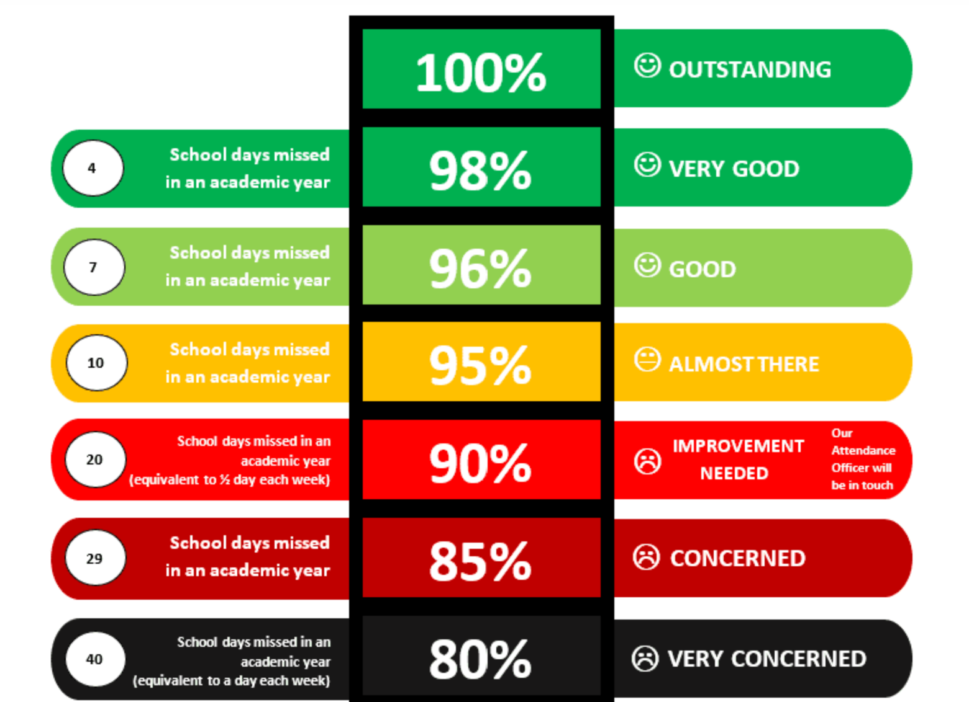
Attendance ladder

Slide 9
Behaviour and Rewards
Our recent OFSTED praised the behaviour strategies we implement and the way in which the children conduct themselves following our school values.
Our Behaviour Policy links specifically to our school values enabling our pupils to focus on gaining rewards for positive behaviour. Children collect rewards/star stamps which they can use in the School Star Shop. We also do Head teacher awards which are popular. We will be bringing back attendance awards this year too.
Fundamentally the way we behave and act is a choice. We are teaching our children about how to live their life and make the right choices. We know that our behaviours can impact on our own and others ability to play, learn, socialise and have fun.
A copy of the Behaviour Policy will be sent out to all families and can be found on the school website.

Slide 10
Homework
We expect children to read every evening (not necessarily to an adult) for approximately 10 minutes and parents must sign the reading record. We will check this daily and children will be rewarded each week. There is a new reading reward system being introduced this year.
Yr 2- Number bond work as well as spelling and Grammar homework. Please note only one piece of homework comes out per week and it is set on a Friday and expected to be returned by the following Thursday.
Spelling homework does not go home and we do not have the weekly spelling tests however, weekly practice of the Year group Common Exception words would go a long way to helping your child with their writing. Copies of these will be sent out to you and a copy can be found on the website page.
All homework is targeted at what has been covered in class therefore, will be very familiar to your child. I encourage that it is completed as independently as possible however, if there are any concerns please come and see me.
This will begin over the coming weeks once we are all settled into our environment and routine.

Slide 11
PE
Children in year 2 will have PE on Monday afternoons. Please ensure that your child has their PE kit in school which must be labelled.
We will be starting swimming on Friday 13th September. Please ensure that your child has their swimming bags in school every Friday to avoid them missing out on their session.
Please note NO watches, jewellery, earrings.
School PE kits MUST be worn- not football shirts, other coloured tops, etc.

Slide 12
Topics
  Towers, Tunnels and Turrets- (Warwick Castle Trip 19th September)
  Beat, Band, Bougie
  Land Ahoy
  Street Detectives
  Scented Garden
  Beach Combers – (Llandudno Trip – Date TBC)

Slide 13
Additional information
All resources are provided for your child at St Oswald’s.
Please ensure your child brings their book bag into school everyday with their reading books and home school diary.
Please do not send children in with any toys or objects from home. As these are kept in our cloakroom; small objects often get lost.
A summer cap is essential. Please ensure this is named.
Please ensure all school uniform, bags, coats, PE kit, hats, shoes are labelled with your child’s name in it.
Please ensure your child brings a waterproof coat everyday (we cannot always rely on the weather forecast).

Slide 14
We operate an open door policy and are always available to support and help you as a family in anyway we possibly can.
This could be sign posting for support or meeting to discuss ways in which we as a school can support your child on their educational journey.
All information is shared amongst the team within the class.

Slide 15
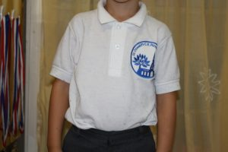
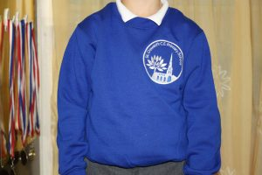
School Uniform
We expect every child to wear the St Oswald’s school uniform. If for any reason you are struggling then we have preloved uniform available in school.
Please see Miss Simons.

Slide 16
Essential jumper or cardigan (embroidered with the primary school logo) £10.50
Essential Polo Shirt (embroidered with the primary school logo) £6.50
(No Woollen or navy cardigans)
Button Fronted Gingham Dress (embroidered with the primary school logo) £15.00
Fleece Jacket (embroidered with the primary school logo) £13.00
Other items of clothing (this is not able to be purchased in school)
Girls to wear grey tights or grey socks/white socks (no patterned tights)
Girls to wear GREY skirts, shorts, pinafore dress or trousers (NOT Black or blue)
Boys to wear GREY trousers or shorts (NOT black or blue)
Boys to wear GREY socks
Boys to wear leather black school shoes (no canvas shoes or trainers or boots)
Girls to wear black leather/patent shoes (no canvas shoes, trainers or open toed sandals or boots.)
In Infants please can you ensure children have Velcro shoes not laces or buckles

Slide 17
Thank you for listening!
We are looking forward to helping your child grow!

