Slide 1
Whitemoor Lakes Residential
Monday 15th to Wednesday 17th September 2025

Slide 2
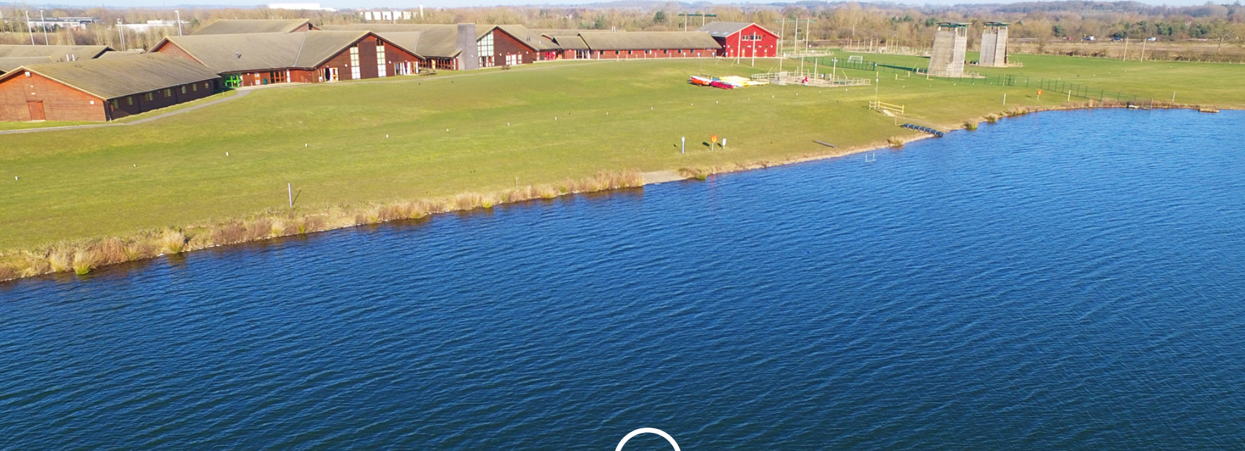
What can you expect?

Slide 3
Whitemoor Lakes is a purpose-built Activity centre.
We have asked for our groups to take part in water based activities and adventurous activities.
We will leave school at 10.30am Monday morning and arrive at 11.30am.
On the return journey we will return to school for approximately
3.15/3.30pm on Wednesday.

Slide 4
What do we need?
Kit List- on the school website too.
Look at what you need to wear on the first day - if you are doing a water based activity, wear clothes and shoes that you don’t mind getting wet.
Bring a bin/plastic bag to put wet/dirty clothes in.
Bring some spare clothes.
Bring a coat.
Souvenir shop; Bring money for the souvenir shop. There is a pool table and a vending machine which takes 50p and £1 coins.
No electronic devices are permitted, including Gameboys, Nintendo switches, mobile phones, air-tags, smart watches etc.

Slide 5
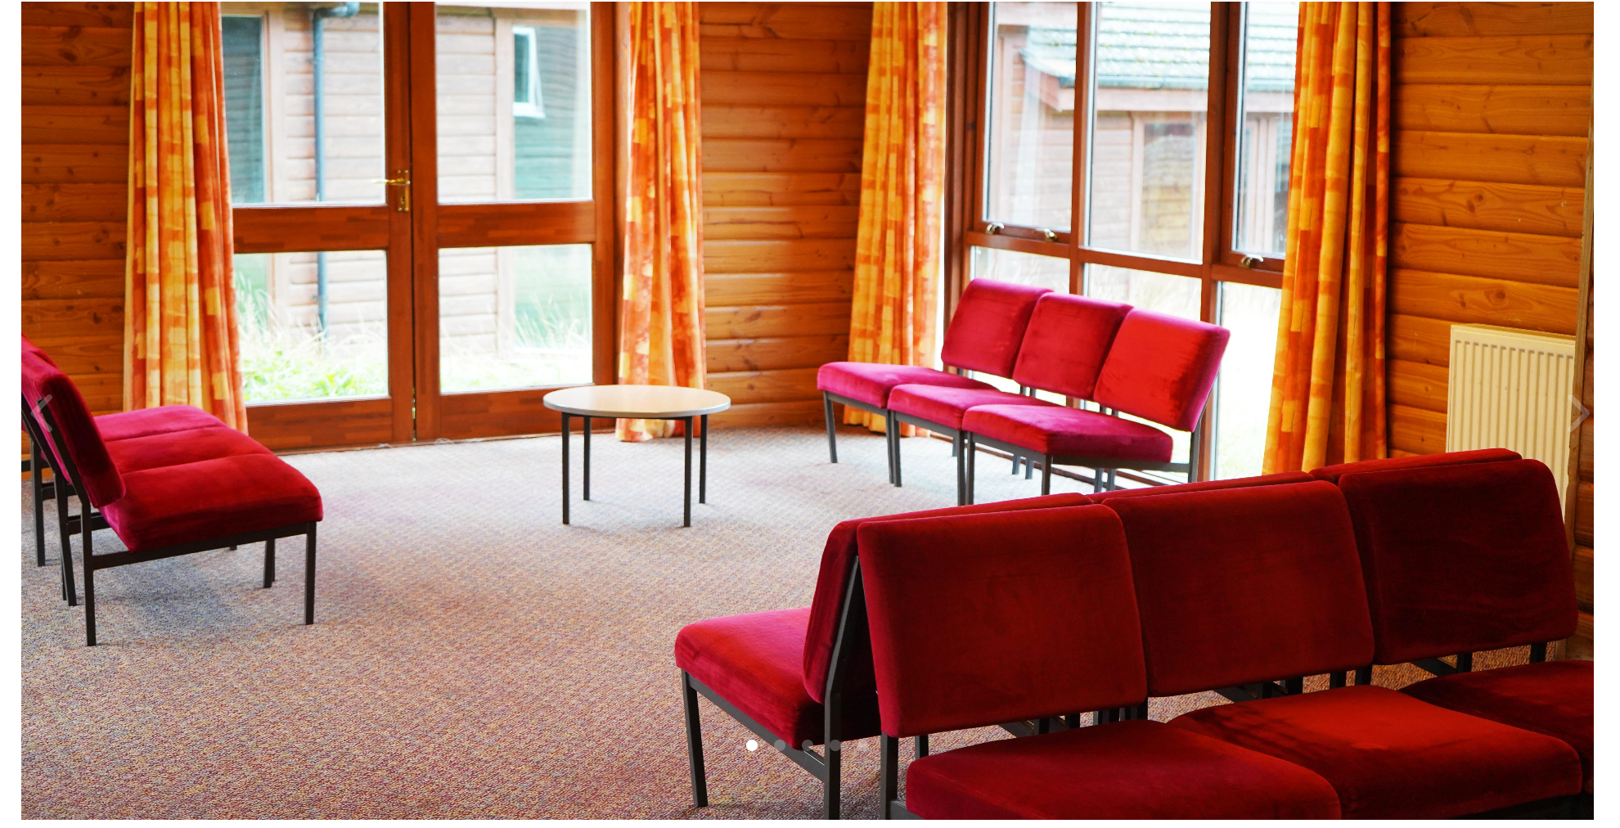
Our lodge at Whitemoor Lakes.
Our lodge is just for St. Oswalds and includes all our bedroom, our own lounge area and kitchenette.
Groups often use these spaces to relax in their free time but they can also be used as an additional meeting space.
Our kitchenettes are stocked with tea and coffee, equipped with a kettle, sink and a fridge to store any snacks. Some of our lodges also have microwaves.

Slide 6
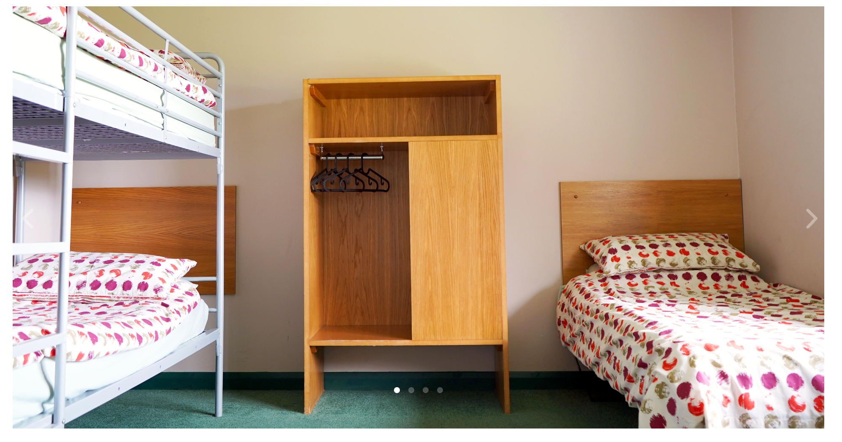
Bedrooms
All the rooms are ensuite, giving comfort to all ages, fitted with bath and shower facilities.
“We know how difficult it can be to get a group to sleep, that’s why our rooms don’t sleep more than eight people.”
Each lodge has a room set aside for leaders. These rooms are spacious, offer easy access to the lodge lounge and are furnished with two or three single beds.

Slide 7
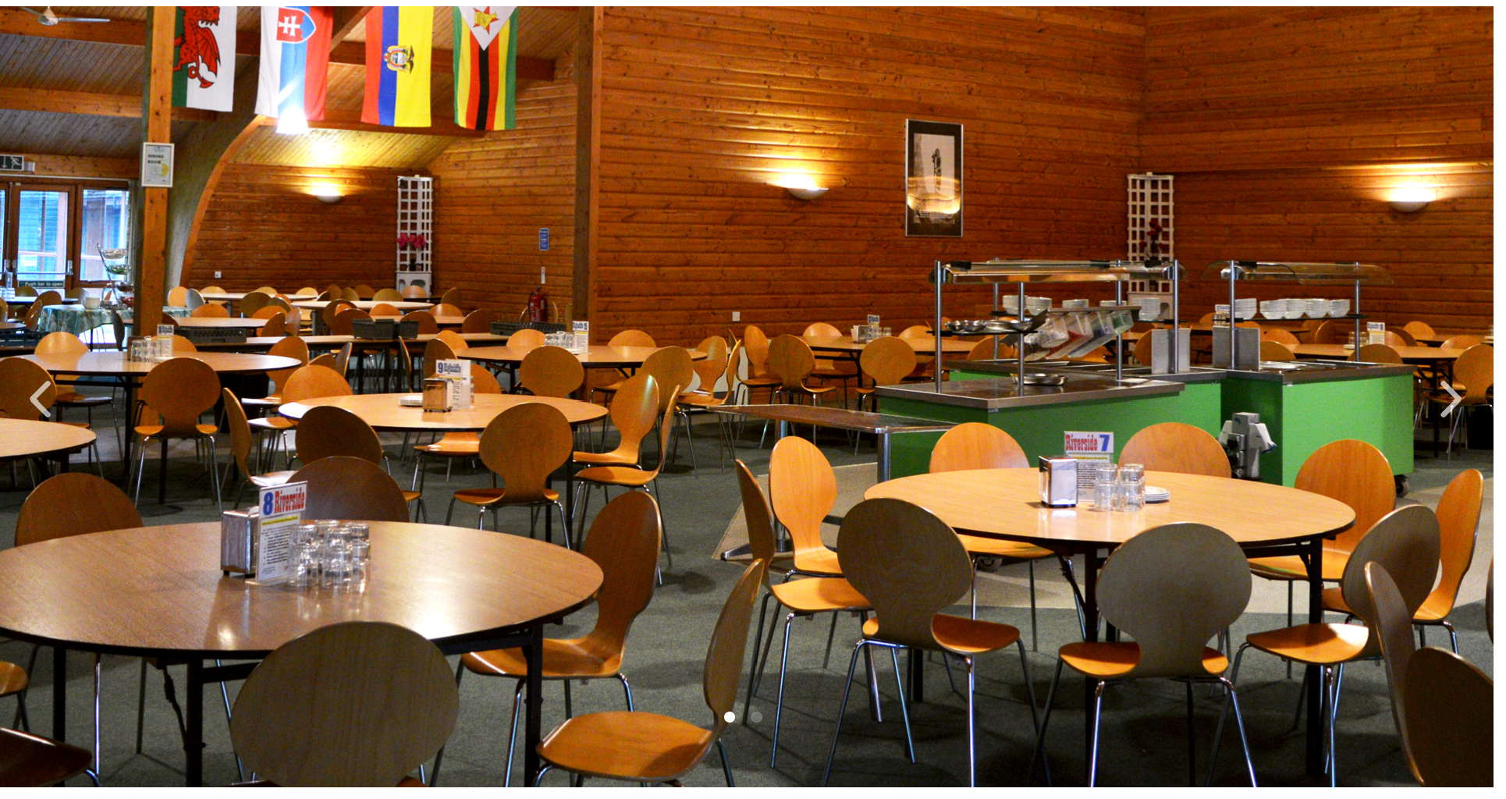
Catering
Our stay is fully catered.
There is a large dining hall so our whole group can sit together for meal times.
They provide three meals a day including halal and vegetarian diets. For breakfast; a cooked breakfast, cereals, toast and fruit juice. For lunch and dinner; two courses that are accompanied by our varied salad bar.
Bring a packed lunch on the first day. The evening meal will be provided and all the meals on the second and third day.

Slide 8
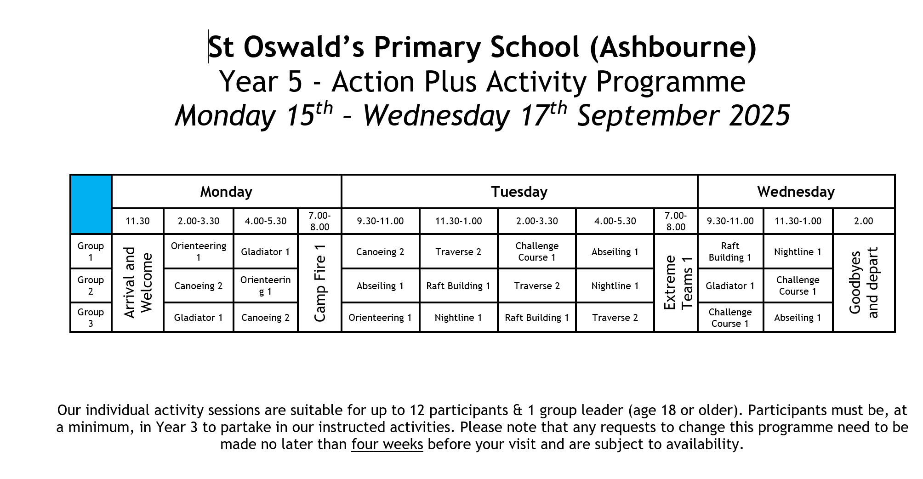
If your child is in Group 2 or Group 3, they need to arrive on Monday morning, already wearing clothes and shoes for the water.

Slide 9
Finally …
All that is left to do is to have FUN!
Any questions?

