Slide 1


Welcome to the Academic Year 2024-2025
September 2024

Slide 2
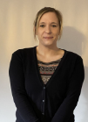
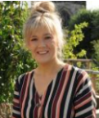
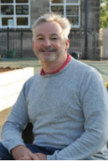
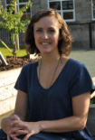
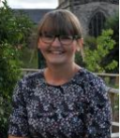
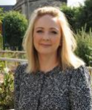
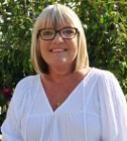
Meet the Year 4 Team
Miss Austin
Year 4 Class Teacher
(Friday)
Dr Collinge
Teaching Assistant
(Monday-Friday AM)
Mrs Bunting
Year 4 Class Teacher
(Monday-Thursday)
Mrs Dacre
SENTA
(Monday-Friday AM)
Mrs Morgan
SENTA
(Monday-Thursday PM)
Mrs Bould
SENTA
(Friday PM)
Midday Day Supervisor
Mrs Roper
(Monday – Fridays)

Slide 3
School Vision and Values
‘Learning and Growing Together’
Is underpinned by our school’s core values of Hope, Friendship, Forgiveness, Perseverance,
Respect, and Honesty.
We nurture the tiny seeds (that are each individual child and our community) to grow into the mighty tree, as Jesus describes the Kingdom of Heaven (Parable of the Mustard Seed- Matthew 13)
Individuals flourish in a school which is a safe, respectful and welcoming Christian community.
Learning-
we develop our wisdom, knowledge and skills
Growing-
in our character development, hope, aspiration, resilience and social action
Together-
so our community can live well together, showing dignity and respect.
Our Core School Values are Honesty, Hope, Forgiveness, Friendship, Perseverance and Respect. They permeate through school life and we ensure that our pupils live by these values in the way they conduct themselves in school, their behaviours in school and outside school.
These School Values are linked to the school code of conduct.

Slide 4
Beginning and end of the school day
Doors open at 8.45am. Doors close at 8.55 am
Register is 8.55-9am
All pupils finish at 3.15pm
Your child will come to school via the kissing gate and will wait by their classroom door to be let in. An adult will be by this gate to greet your child and lock up.

Slide 5
Attendance
Attendance at school is crucial.
You will receive a copy of the Updated Attendance policy. Any days where a child does not attend school means that they are missing out on learning. The attendance ladder on the next slide shows a clear image of absence and days lost learning.
We completely understand and appreciate when your child is unwell (temperature, sickness, diarrhoea). However, holidays and days off where we are unsure where your child is will be unauthorised and as per the new policy and expectations from the DFE, a procedure for fines will be followed.
This also applies to any incidents where your child is brought to school late.

Slide 6
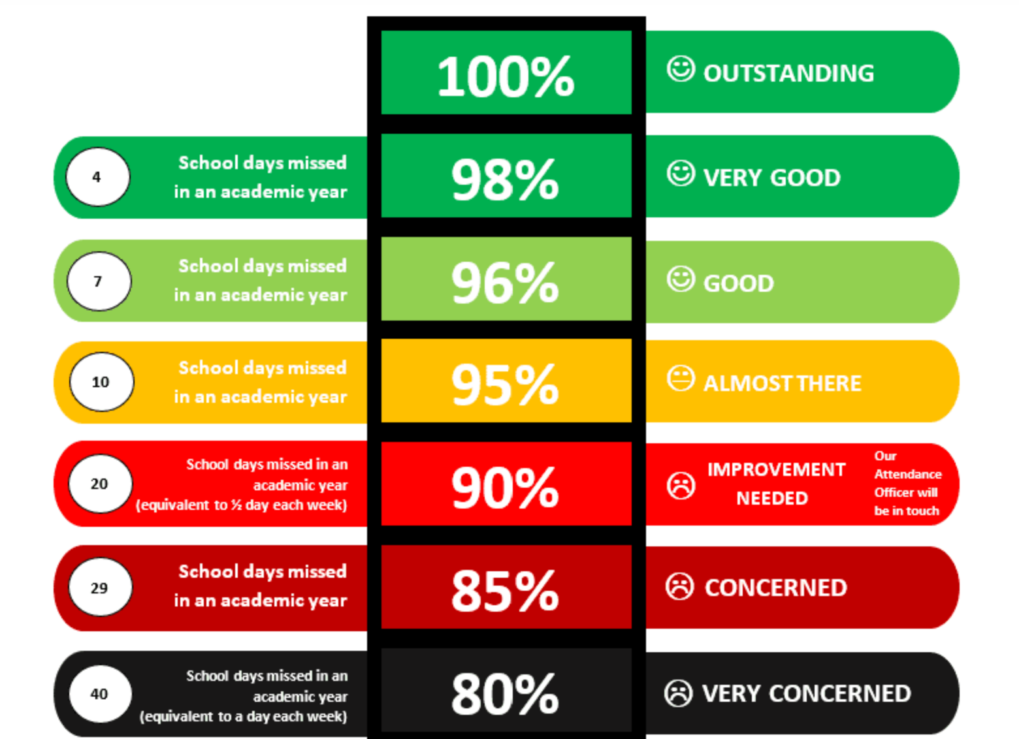
Attendance ladder

Slide 7
Behaviour and Rewards
Our recent OFSTED praised the behaviour strategies we implement and the way in which the children conduct themselves following our school values.
Our Behaviour Policy links specifically to our school values enabling our pupils to focus on gaining rewards for positive behaviour. Star Stamps are rewarded and children are able to use these in the school shop throughout the year.
Raffle tickets are also rewarded in class and are put into a jar. 3 winners are drawn every Friday afternoon and children can pick a small prize.
We also do Headteacher awards every Thursday.
Attendance rewards are also presented at the end of each half term.
Fundamentally the way we behave and act is a choice. We are teaching our children about how to live their life and make the right choices. We know that our behaviours can impact on our own and others ability to play, learn, socialise and have fun.
A copy of the Behaviour Policy will be sent out to all families and can be found on the school website.

Slide 8
Homework
Reading
We expect children to read every evening (not necessarily to an adult) for approximately 10 minutes and parents must sign the reading record. We will check this daily and children will be rewarded each week. There is a new reading reward system being introduced this year.
Spellings
Spelling homework does not go home and we do not have a weekly spelling test. However, weekly practice of the Year group Common Exception words would go a long way to helping your child with their writing. Copies of these will be sent out to you and a copy can be found on the website page.

Slide 9
Maths and English Homework
There will be Maths and English homework set on a Friday each week. This must be returned by the following Thursday to allow us to mark it. In the event your child forgets which pages your child will write this in their homework diary also.
All maths and English homework is linked to what your child has been learning in school and therefore they should be able to complete independently in either pencil, blue/black biro. Please encourage children to present their homework well and to take time with their presentation.

Slide 10
Topic Homework
During the year there may have been a topic that has captured your children’s interest and imagination so we may set some topic based homework for them to complete in their own way/in their own time. We will expect children to be aware of when this is set and if it is required to be completed by a certain date and when it should be bought back to school.

Slide 11
Ideas for helping your child at home
Encourage your child to read every day.
Involve your child in everyday maths opportunities e.g take your child shopping and talk about the quantities of anything you buy; let your child handle money and work out how much things cost.
Find a quiet place at home to use as a homework area. They will need a flat surface, a good light source, and the right equipment.
Plan a homework timetable and agree on when your child will do their homework.
Discuss any homework tasks with your child and how it connects with what they are studying at school.

Slide 12
Statutory Tests
The multiplication tables check is an online assessment given to pupils in year 4. It checks their ability to fluently recall times tables up to 12x12.
The check is made up of 25 times tables questions. Your child will be able to answer 3 practice questions before taking the actual check. They will then have 6 seconds to answer each question. On average, the check should take no longer than 5 minutes to complete.
There is no expected standard or ‘pass mark’ for the multiplication tables check, but higher scores indicate greater proficiency in fluently recalling multiplication tables. We will share your child’s score with you.
We strongly advise that you do not book any holidays or take your child out of school during this period.

Slide 13
How will I know what will my child be learning?
Each half term you will receive an overview of what your child will be learning.
The homework your child brings home is also an indication of what has been taught that week in the class.
Please keep checking your child’s class page on the website as updates are put on half termly.

Slide 14
Opportunities
In Year 4 PE takes Place on a Wednesday afternoon. Children are to come in their PE Kits.
Please note No watches, Jewellery, earrings, etc, for PE.
School PE kits must be worn- not football shirts, other coloured tops, etc.. Remember we are representing St Oswald’s.
In Year 4 pupils will have the opportunity to have focused teaching of a Musical Instrument. This will happen every Tuesday afternoon for a Year.

Slide 15
School day
Door opens at 8.45 and closes at 8.55. Register is 8.55-9am.
If you are late please go to the School Office where Miss Simons will mark you in school
Please ensure your child is punctual as learning starts at 9am.
Attendance at school is crucial to your child’s learning.
Break time; In Year 4, children will need to bring in their own named water bottle. Only water please- no fruit juices, fizzy drinks etc… Children can also bring in a healthy snack- as per our policy this is fresh fruit or fresh vegetables.
Lunchtime; Meals are now cooked on the school site following the installation of the cooking kitchen. Details and information about school meals will be shared.

Slide 16
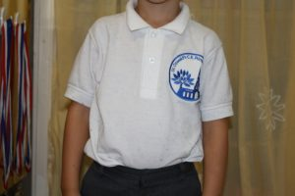
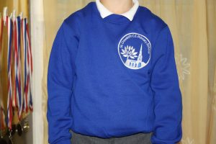
School Uniform
We expect every child to wear the St Oswald’s school uniform. If for any reason you are struggling then we have preloved uniform available in school. Please see Miss Simons.

Slide 17
Essential Sweatcardi (embroidered with the primary school logo) £11.95
Essential Polo Shirt (embroidered with the primary school logo) £8.45
(No Woollen or navy cardigans)
Essential Crew Neck Sweatshirt (embroidered with the primary school logo) £10.55
Other items of clothing (this is not able to be purchased in school)
girls to wear grey tights or grey socks/white socks (no patterned tights)
girls to wear GREY skirts, shorts, pinafore dress or trousers (NOT Black or blue)
Boys to wear GREY trousers or shorts (NOT black or blue)
Boys to wear grey socks
Boys to wear leather black school shoes (no canvas shoes or trainers or boots)
Girls to wear black leather/patent shoes (no canvas shoes, trainers or open toed sandals or boots.)
In Infants please can you ensure children have Velcro shoes not laces or buckles

Slide 18
Resources
All resources are provided for your child at St Oswald’s.
In Juniors children sometimes like the independence of having their own resources. We do request if your child does want to bring in their own resources, that they have a small pencil case which they are able to fit inside their drawer.

Slide 19
Topics this Year
Our Topics this year are:
Autumn 1: Potions
Autumn 2: Play List
Spring 1: I am Warrior
Spring 2: Blue Abyss
Summer 1: Traiders and Raiders
Summer 2: Burps, Bottoms and Bile

Slide 20
Educational Visits
All visits which we take our children on are linked to the learning that they will be doing in class. They will be focused to enhance the children's knowledge of a topic or piece of learning.
If we cannot go out on a visit then we will have visitors who will come into school.
This year we are planning the following Visits:
Roman History Van visit to school in Spring 1 term.
National Sealife Centre Birmingham in Spring 2 term.
2 science topic based farm Visits to Headlow Farm, Snelston during Spring 2 and Summer 1.

Slide 21
Thank you for listening.
We operate an open door policy and are always available to support and help your child and you as a family in any way we possibly can. This could be sign posting for support and advice or meeting to discuss ways in which we as a school can support your child on their educational journey.
All information is shared amongst the team within the class.

