Slide 1


Welcome to the Academic Year 2026-2027
September 2026

Slide 2
Meet the Year 6 Team
Class teacher – Mr Wood​
Teaching Assistants – Mrs Richmond
MDS – Mrs Mowatt

Slide 3
School Vision and Values
‘Learning and Growing Together’
Is underpinned by our school’s core values of Hope, Friendship, Forgiveness, Perseverance,
Respect, and Honesty.
We nurture the tiny seeds (that are each individual child and our community) to grow into the mighty tree, as Jesus describes the Kingdom of Heaven (Parable of the Mustard Seed- Matthew 13)
Individuals flourish in a school which is a safe, respectful and welcoming Christian community.
Learning-
we develop our wisdom, knowledge and skills
Growing-
in our character development, hope, aspiration, resilience and social action
Together-
so our community can live well together, showing dignity and respect.
Our Core School Values are Honesty, Hope, Forgiveness, Friendship, Perseverance and Respect. They permeate through school life and we ensure that our pupils live by these values in the way they conduct themselves in school, their behaviours in school and outside school.
These School Values are linked to the school code of conduct.

Slide 4
Beginning and end of the school day
Doors open at 8.45am. Doors close at 8.55 am
Register is 8.55-9am
All pupils finish at 3.15pm
Your child may walk to and from school by themselves. Please ensure that you have responded to the MS Forms email sent to you from Ms Simons.

Slide 5
Attendance
Attendance at school is crucial. Our Attendance for last academic year was above National at 95.7% which means we are in line with national figures. This is great but there is always room for improvement!
You will receive a copy of the Attendance policy. Any days where a child does not attend school means that they are missing out on learning. The attendance ladder on the next slide shows a clear image of absence and days lost learning.
We completely understand and appreciate when your child is unwell (temperature, sickness, diarrhoea). However, holidays and days off, where we are unsure where your child is will be unauthorised, and as per the new policy and expectations from the DFE, a procedure for fines will be followed.
This also applies to any incidents where your child is brought to school late.

Slide 6
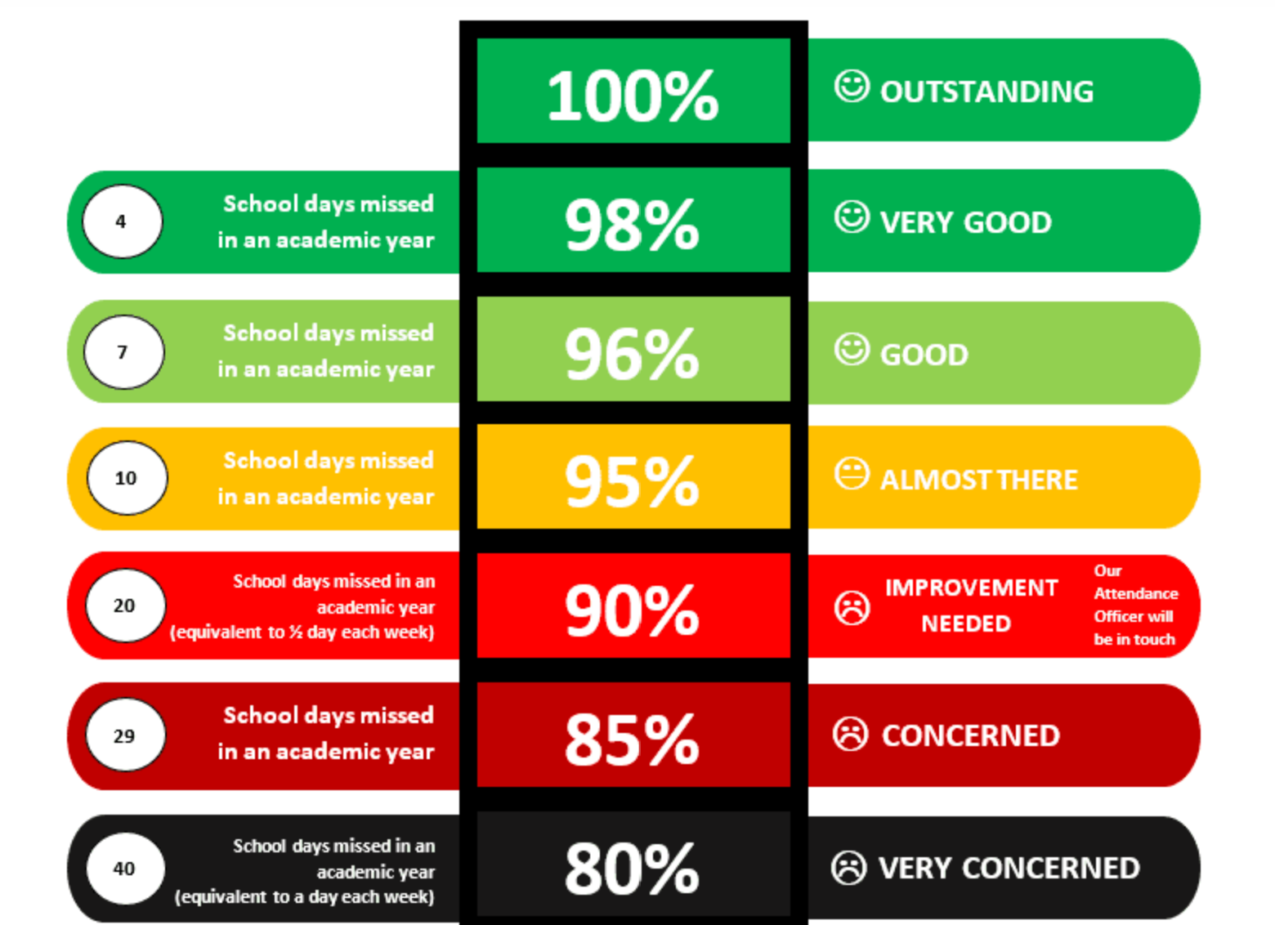
Attendance ladder

Slide 7
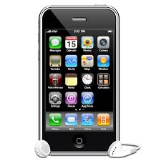
Mobile Phones
As your child is in Year 6 and they are walking to and from school on their own, they may bring mobile phones to school.
They must be handed in as soon as they enter school and switched off. If they are seen to be on their phone on the school site then they will be challenged.
They will be returned at the end of the school day.
If you want to contact your child or you need a message getting to your child, this needs to be done via the school office.
Smart Watches
Smart Watches, Air tags or any recording devices are not allowed on the school premises or on school trips.
This is due to safeguarding of pupils and adults within school.

Slide 8
Online Safety
As children move into Year 5 and 6 they are beginning to make use of wider forms of technology. They may have smart phones.
Starting safe practices in your home is never too early.
  Remember WHATSAPP has a PEGI rating of 16.
  If your child has a You Tube channel does it have the parental settings and controls?
  Do you know who your child is speaking to when they are online?
  Check their phones daily to see the messages/voice notes/videos that are being sent.

Slide 9

Photography and Videoing in school
Following on from a review of photography last year, the Governors have designated the school a ‘No photography’ school. We ask that at any school events you do not take photographs in case other pupils are caught on them in the background.
There are children within the school that risk exposure if they are located through posting photos on social media.

Slide 10
Behaviour and Rewards
Our most recent OFSTED praised the behaviour strategies we implement and the way in which the children conduct themselves following our School values.
Our Behaviour Policy links specifically to our School values, enabling our pupils to focus on gaining rewards for positive behaviour. Children collect rewards/star stamps which they can use in the School Star Shop. We also give out Head teacher awards which are popular. Our Attendance Awards have proven popular with the children as have the Reading Stars.
Fundamentally, the way we behave and act is a choice. We are teaching our children about how to live their lives and make the right choices. We know that our behaviours can impact on our own and others ability to play, learn, socialise and have fun.
A copy of the Behaviour Policy will be sent out to all families and can be found on the School website.

Slide 11
Homework
Reading
We expect children to read every evening (not necessarily to an adult) for approximately 10 minutes, and parents must sign the reading record. We will check this weekly, and children will be rewarded each week. The reading reward system has been very popular this year.
Yr 3/4/5/6; Multiplication/ number bond work improving fluency in maths. TT Rock Stars and Maths.co.uk
Spelling homework does not go home and we do not have weekly spelling tests. However, weekly practice of the Year group Common Exception words would go a long way to helping your child with their writing. Copies of these will be sent out to you and a copy can be found on the website page.

Slide 12
Topic Homework
During the year there may have been a topic that has captured your children’s interest and imagination so we may set some topic based homework for them to complete in their own way/in their own time. We will expect children to be aware of when this is set, if it is required to be completed by a certain date, and when it should be brought back to school.

Slide 13
Maths and English Homework
There will be maths and English homework set each week. In the event your child forgets which pages, your child will write this in their homework diary also.
All maths and English homework is linked to what your child has been learning in school. Therefore, they should be able to complete independently in either pencil, blue/black biro.
Children who do not submit homework on time will have the opportunity to complete this during a break or lunchtime.

Slide 14
Ideas for helping your child at home
Reading – when you listen to, or read with your child, discuss with them how and why characters might be feeling. This is one of the harder reading skills that we will look to develop this year. E.g. Your child might answer your question by saying, ‘I think that Mrs Trunchbull is feeling cross and angry.’ You might reply to this by asking, ‘What makes you think that?’. To which they might respond, ‘ On this page it says that she has steam coming out of her ears.’​
Maths – Year 6 children need to know the times tables up to 12x12. Please encourage your child to use TT RockStars and Doodle Maths. You can also ask them times table questions. Be brave, get them to ask you questions too. A fun way to do this is to play ‘times table tennis.’ Take it in turns to say the answers in a specific table. So, you might go first and say 7, and your child returns with 14 etc etc.

Slide 15
Statutory Tests
Year 6 SAT’s will take place from Monday, 10th May until Thursday 13th May and will continue for 4 days.
Do not book any appointments or holidays during the SAT’s week, or the weeks prior to it.

Slide 16
How will I know what will my child be learning?
Each half term you will receive an overview of what your child will be learning.
The homework your child brings home is also an indication of what has been taught that week in the class.
Please keep checking your child’s class page on the website as updates are put on every half term.

Slide 17
RSE (Relationship and Sex Education)
In the Summer term and during the year your child will be taught Relationship and Sex Education. This is a spiral curriculum which builds each year and teaches the children the correct terminology to be used via child friendly resources, books and videos.
The specific objectives the children will be taught are: consider puberty; reproduction in the context of relationships; the process of conception in heterosexual and homosexual relationships; what being a parent involves; identify the different genders people identify as; appreciate a range of responses to change; and being able to mark transition in terms of moving on and saying goodbye.
Further information can be found about what the children will be learning about on our school website RSE page.

Slide 18
Opportunities
PE in Year 6 takes place on a Wednesday afternoon.
Please note - No watches, jewellery, earrings, etc, for PE.
School PE kits must be worn- not football shirts, other coloured tops, etc. Any tracksuits trousers/leggings must be plain and not have logos on them. Remember we are representing St Oswald’s.

Slide 19
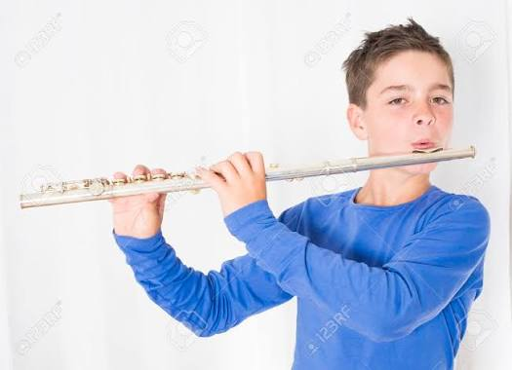
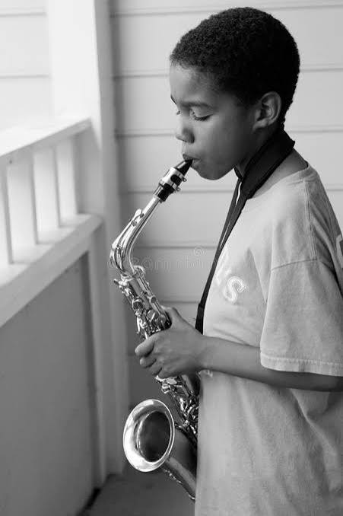
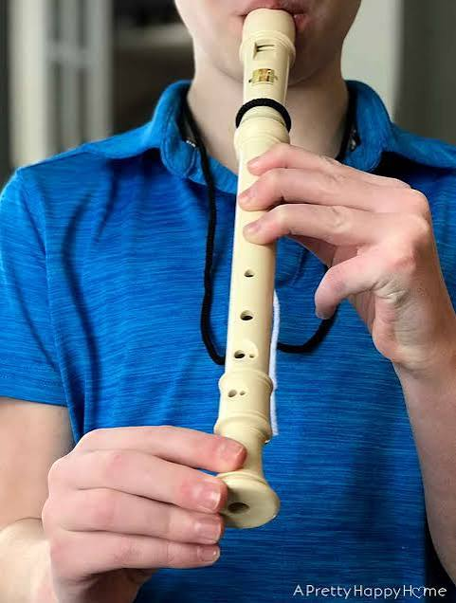
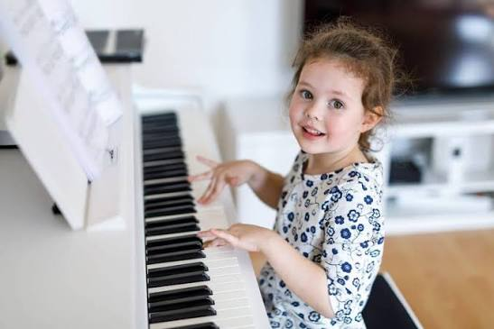
Music at St. Oswald’s.
Every week, each class has a music lesson.
There are extra-curricular activities:
Ukulele Club at lunchtime (Y4-Y6)
Recorder Club at lunchtime (Y2-Y6 £2/week)
iRock band sessions on Wednesdays during school Y1-Y4 (after-school for Y5/Y6)
instrumental lessons in piano (Contact Grace Secretan on 07931 081886)
and woodwind (Contact Natalie Light on 07860 369816)

Slide 20

Any questions?

Slide 21
School day
Door opens at 8.45 and closes at 8.55am. Register is 8.55-9am.
If you are late, please go to the school office where Miss Simons will mark you in school.
Please ensure your child is punctual as learning starts at 9am.
Attendance at school is crucial to your child’s learning.
Your child will need to bring in their own named water bottle. Only water please- no fruit juices, fizzy drinks etc… Children can also bring in a healthy snack- as per our policy this is fresh fruit or fresh vegetables.
Lunchtime: Details and information about the lunch menu will be shared.

Slide 22
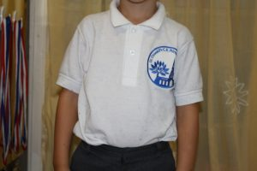
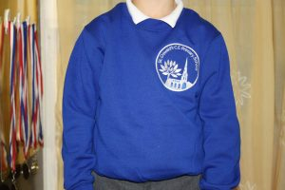
School Uniform
We expect every child to wear the St Oswald’s school uniform. If for any reason you are struggling then we have preloved uniform available in school. Please see Miss Simons.

Slide 23
Essential Sweatcardi (embroidered with the primary school logo) £10.50
Essential Polo Shirt (embroidered with the primary school logo) £6.50
(No Woollen or navy cardigans)
Button Fronted Gingham Dress (embroidered with the primary school logo) £15.00
Fleece Jacket (embroidered with the primary school logo) £13.00
Other items of clothing (this is not able to be purchased in school)
Girls to wear grey tights or grey socks/white socks (no patterned tights)
Girls to wear GREY skirts, shorts, pinafore dress or trousers (NOT Black or blue)
Boys to wear GREY trousers or shorts (NOT black or blue)
Boys to wear grey socks
Boys to wear leather black school shoes (no canvas shoes or trainers or boots)
Girls to wear black leather/patent shoes (no canvas shoes, trainers or open toed sandals or boots.)
In Infants please can you ensure children have Velcro shoes not laces or buckles

Slide 24
Resources
All resources are provided for your child at St Oswald’s. However, in Juniors children like the independence of having their own pencil case and additional resources which they can keep in their bags.
In PE the junior children will be playing Hockey using wooden hockey sticks. The school will provide children with shin pads, but children will need their own gum shields. Please purchase your child’s own gum shield and then this can be kept in school for the duration of this section in PE. Due to health and safety, they will not be able to take part in the hockey lessons without a gum shield.

Slide 25
Educational Visits
All visits which we take our children on are linked to the learning in class. They will be focused to enhance the children's knowledge of a topic or piece of learning.
If we cannot go out on a visit then we will have visitors who will come into school.
This year we are planning the following visits – Imperial War Museum (Salford) and Magna Science Adventure Centre near Sheffield.

Slide 26
Food Intolerances
We have more and more children in our school who have allergies, some severe, requiring them to have epi pens close by.
As a result, we ask you to refrain from any nuts as part of snacks.
We also ask that you no longer bring in cakes or treats when there is a birthday due to the range of allergies within each class.

Slide 27
Thank you for listening.
We operate an open-door policy, and are always available to support and help your child and you as a family, in any way we possibly can. This could be sign posting for support and advice, or meeting to discuss ways in which we as a school can support your child on their educational journey.
All information is shared amongst the team within the class.

