Slide 1
Whitemoor Lakes Residential
Monday 14th to Wednesday 16th September

Slide 2
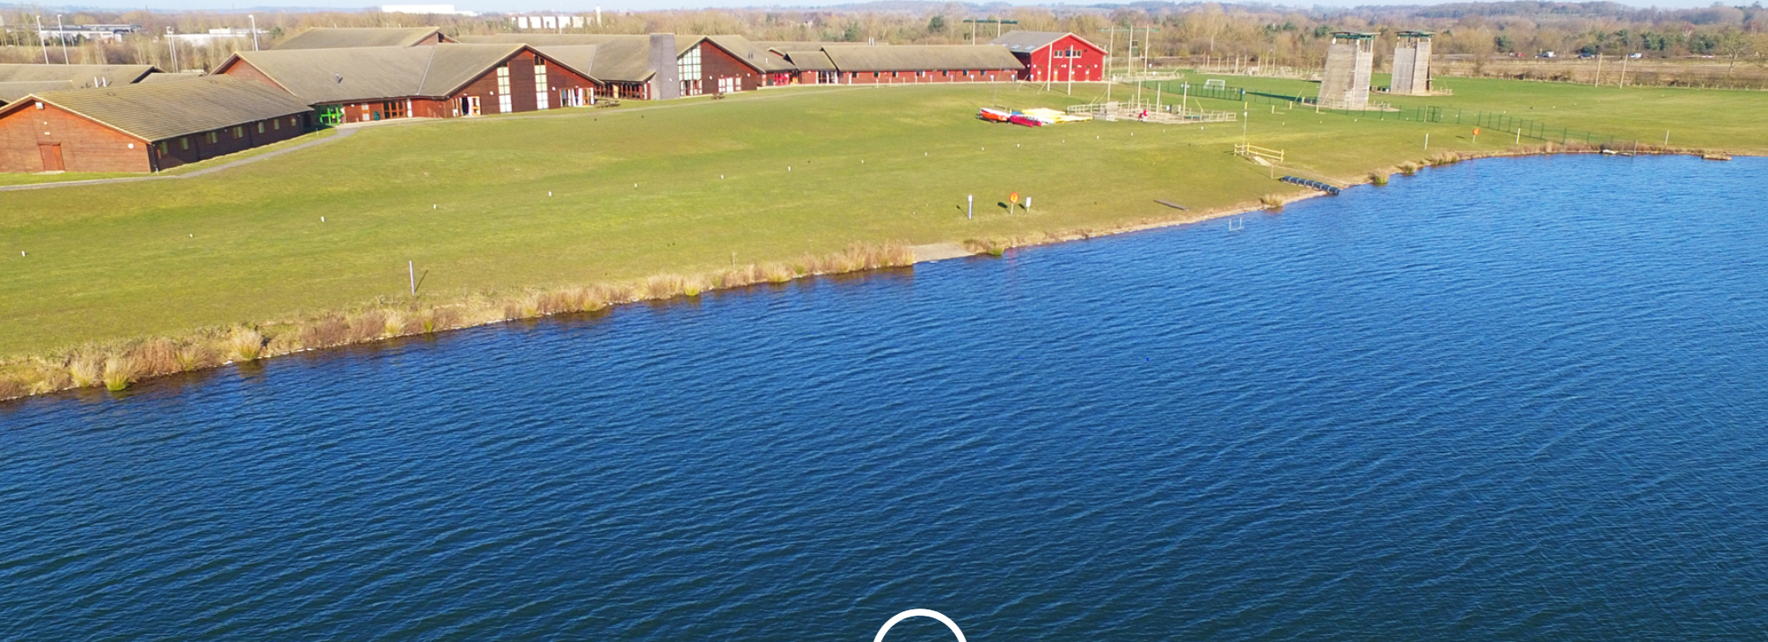
What can you expect?

Slide 3
Whitemoor Lakes is a purpose-built activity centre.
The children wil- take part in water based activities and adventurous activities.
Children arrive at school at the usual time on Monday, in their casual clothes, with their suitcase. We will leave school at 10.30am and arrive at 11.30am.
We will return to school for approximately 3.15/3.30pm on Wednesday. If we are running significantly late, the office will inform you via email.

Slide 4
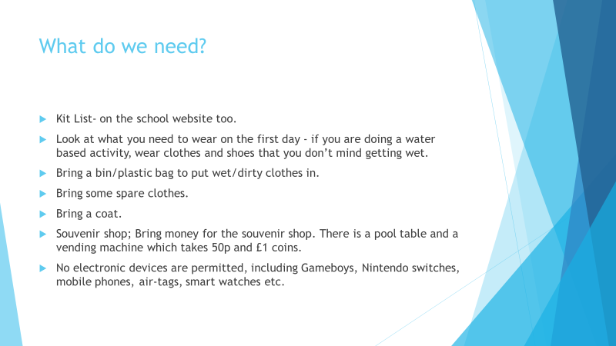

Slide 5
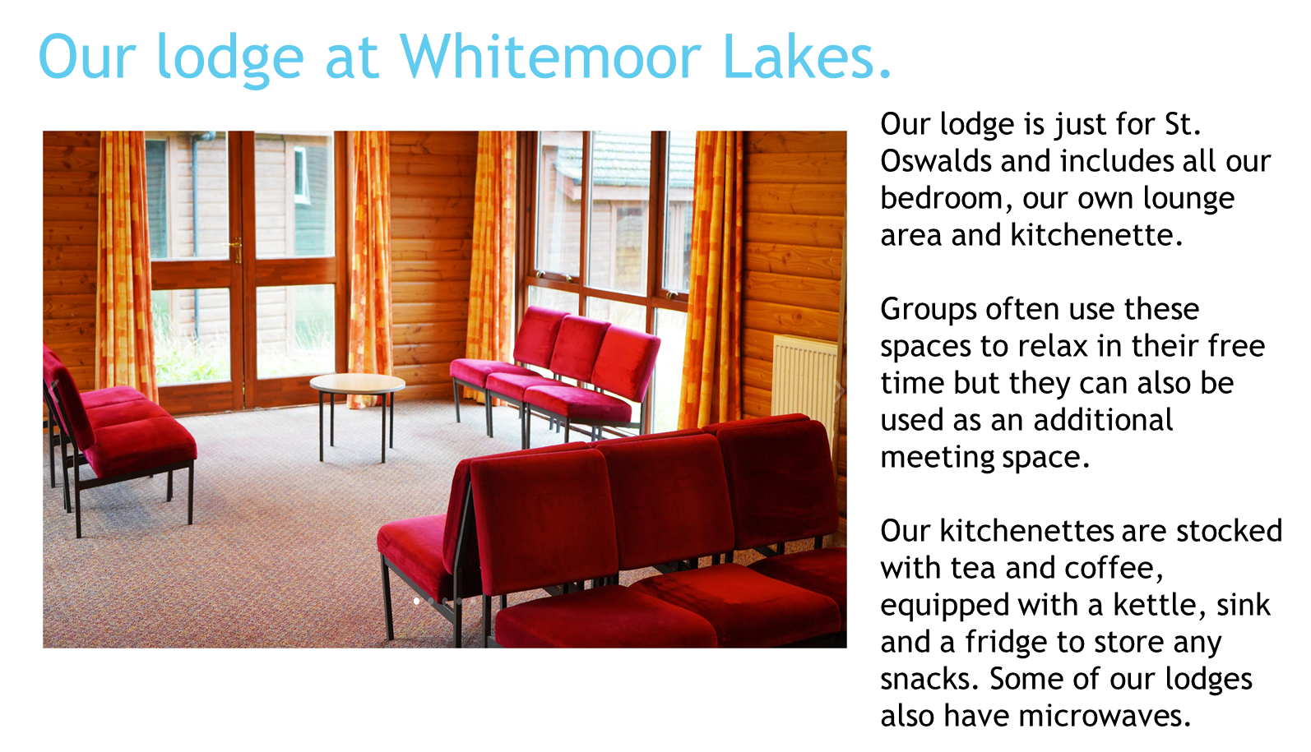

Slide 6
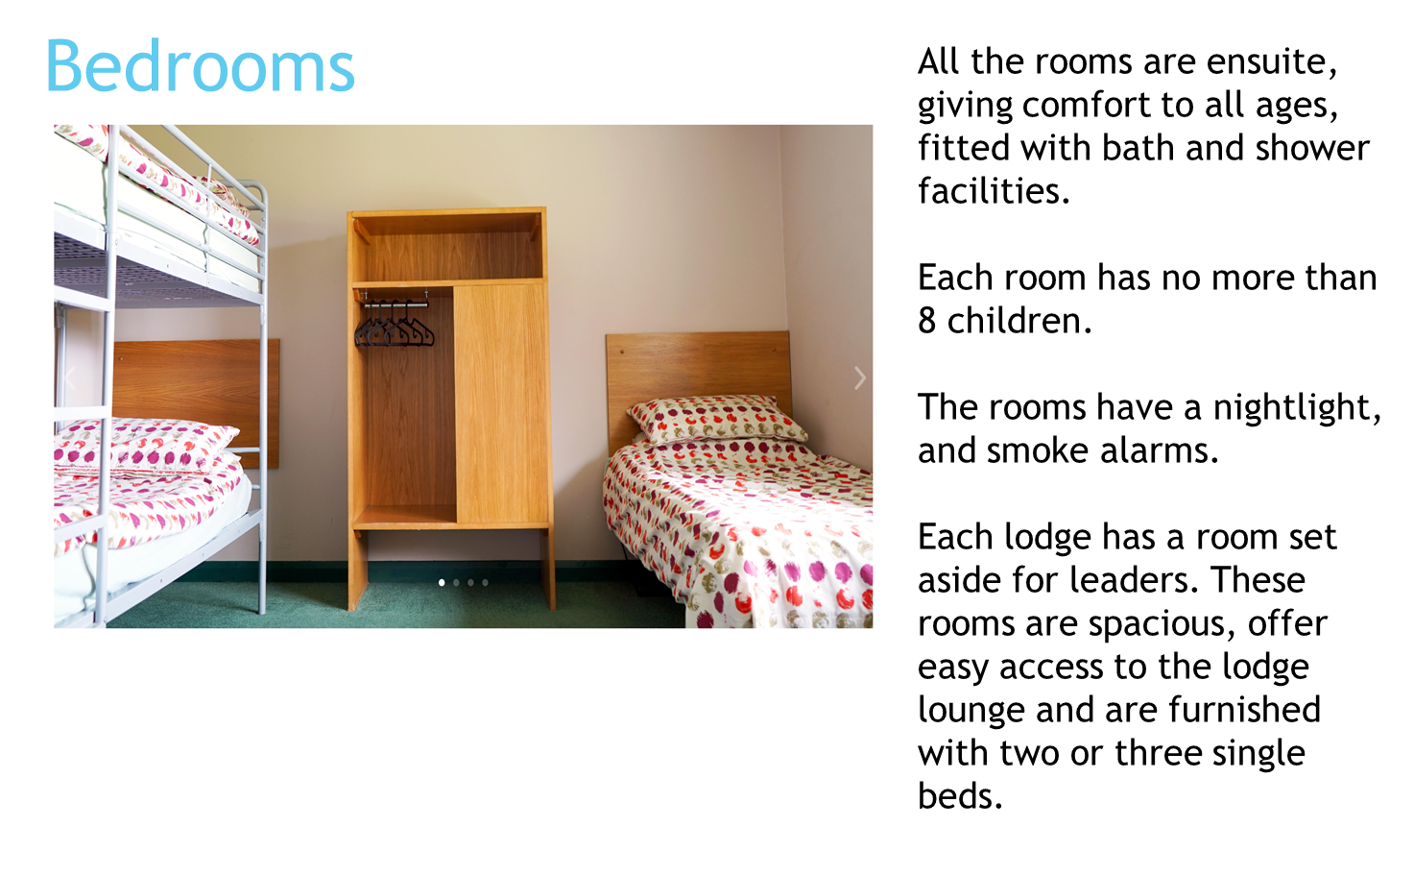

Slide 7
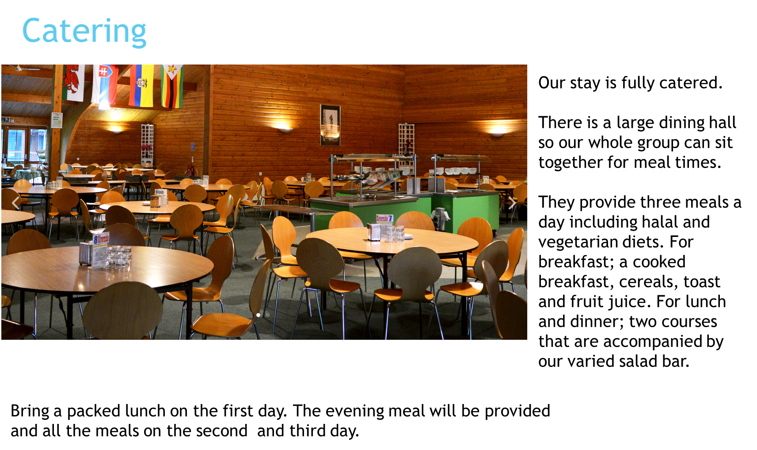

Slide 8
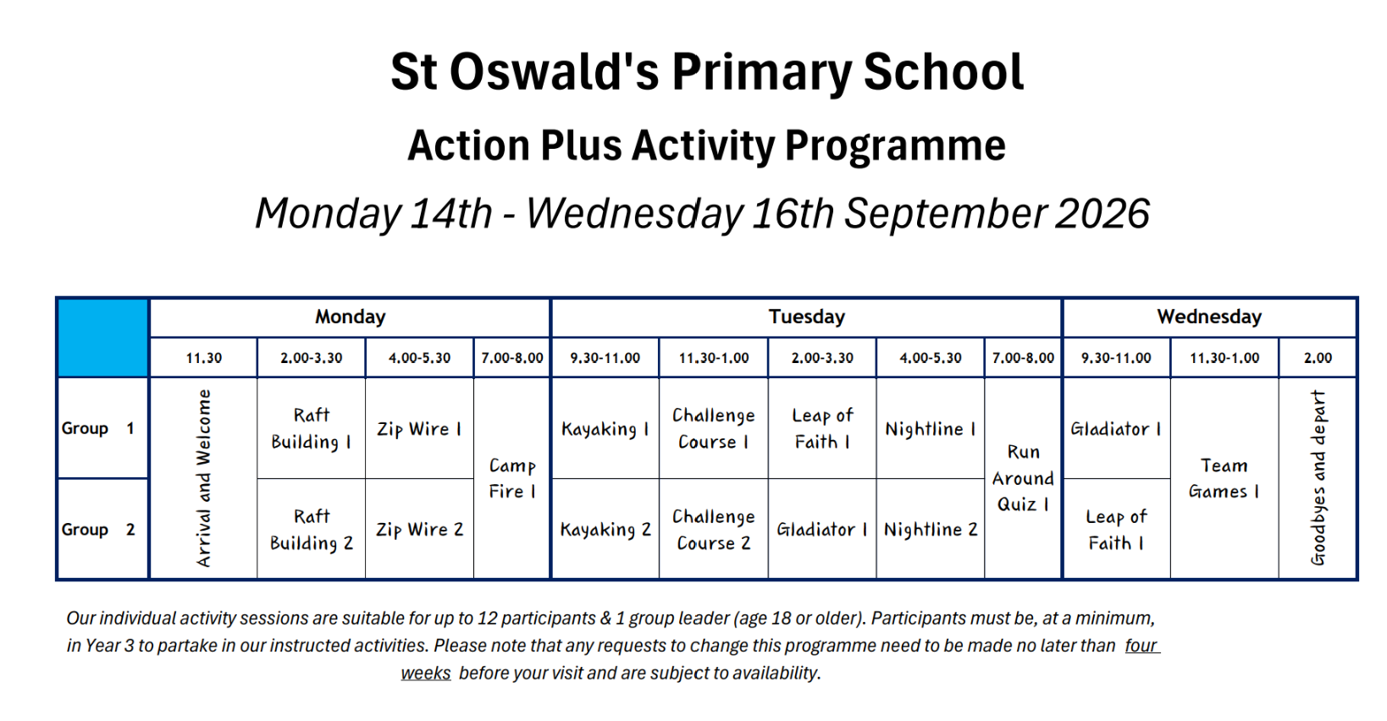
If your child is in Group 2 or Group 3 they need to be wearing the clothes they don’t mind getting wet

Slide 9
Finally
All that is left to do is to have FUN!
We'll do our best to upload photos from each day, to the school instagram account.

