Slide 1


Welcome to the Year 2026-2027
September 2026

Slide 2
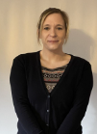
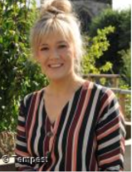
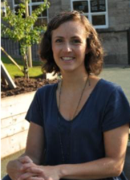
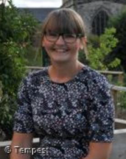
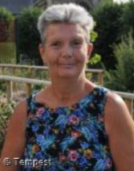
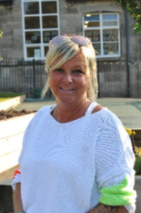
Meet the Year 3 Team
Mrs Bunting
Year 3 Class Teacher
(Monday-Thursday)
Miss Austin
Year 3 Class Teacher
(Friday)
Mrs Morgan
Teaching Assistant
(Monday-Tuesday mornings)
Mrs Bould
Teaching Assistant
(Wednesday - Friday mornings)
Midday Day Supervisor
Mrs Mitchell
(Monday – Friday)
Midday Day Supervisor
Mrs Wadley
(Monday – Friday)

Slide 3
School Vision and Values
‘Learning and Growing Together’
Is underpinned by our school’s core values of Hope, Friendship, Forgiveness, Perseverance,
Respect, and Honesty.
We nurture the tiny seeds (that are each individual child and our community) to grow into the mighty tree, as Jesus describes the Kingdom of Heaven (Parable of the Mustard Seed- Matthew 13)
Individuals flourish in a school which is a safe, respectful and welcoming Christian community.
Learning-
we develop our wisdom, knowledge and skills
Growing-
in our character development, hope, aspiration, resilience and social action
Together-
so our community can live well together, showing dignity and respect.
Our Core School Values are Honesty, Hope, Forgiveness, Friendship, Perseverance and Respect. They permeate through school life and we ensure that our pupils live by these values in the way they conduct themselves in school, their behaviours in school and outside school.
These School Values are linked to the school code of conduct.

Slide 4
Beginning and end of the school day
Doors open at 8.45am. Doors close at 8.55 am
Register is 8.55-9am
All pupils finish at 3.15pm
Your child will wait on the playground by the blue door. They should come up the steps onto the playground.

Slide 5
Attendance
Attendance at school is crucial. Our Attendance for last academic year was above National at 95.7% which means we are in line with National. This is great but there is always room for improvement!
You will receive a copy of the Attendance policy. Any days where a child does not attend school means that they are missing out on learning. The attendance ladder on the next slide shows a clear image of absence and days lost learning.
We completely understand and appreciate when your child is unwell (temperature, sickness, diarrhoea) however holidays and days off where we are unsure where your child is will be unauthorised and as per the new policy and expectations from the DFE a procedure for fines will be followed.
This also applies to any incidents where your child is brought to school late.

Slide 6
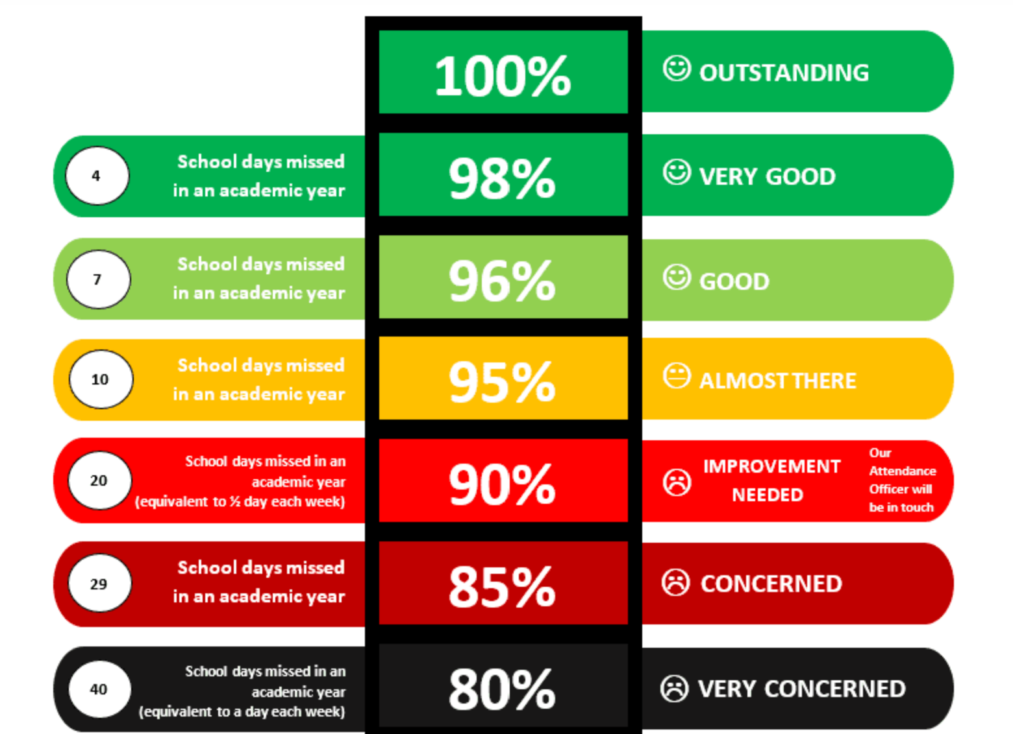
Attendance ladder

Slide 7
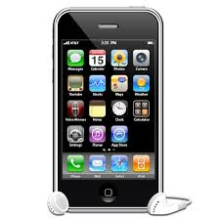
Mobile Phones
Children in Year 3 must not bring mobile phones into school.
If you want to contact your child or you need a message getting to your child this needs to be done via the school office.
Smart Watches
Smart Watches Air tags or any recording devices are not allowed to be on the school premises or on School Trips.
This is due to safeguarding of pupils and adults within school.

Slide 8

Photography and Videoing in school
Following on from a review of photography last year the Governors have designated the school a ‘No photography’ school. We ask that at any school events you do not take photographs in case other pupils are caught on them in the background.
There are children within the school that risk exposure if they are located through posting photos on social media.

Slide 9
Behaviour and Rewards
Our recent OFSTED praised the behaviour strategies we implement and the way in which the children conduct themselves following our school values.
Our Behaviour Policy links specifically to our school values enabling our pupils to focus on gaining rewards for positive behaviour. Children collect rewards/star stamps which they can use in the School Star Shop. We also do Head teacher awards which are popular. Attendance Awards have proven popular with the children as have the Reading Stars.
Fundamentally the way we behave and act is a choice. We are teaching our children about how to live their life and make the right choices. We know that our behaviours can impact on our own and others ability to play, learn, socialise and have fun.
A copy of the Behaviour Policy will be sent out to all families and can be found on the school website.

Slide 10
Homework
Reading
We expect children to read every evening (not necessarily to an adult) for approximately 10 minutes and parents must sign the reading record. We will check this daily and children will be rewarded each week. The reading reward system will restart in September for the new year.
Spellings
Spelling homework does not go home and we do not have a weekly spelling test. However, weekly practice of the Year group Common Exception words would go a long way to helping your child with their writing. Copies of these will be sent out to you and a copy can be found on the website page.
Maths
Multiplication/number bond work improving fluency in maths. TT Rock Stars.

Slide 11
Maths and English Homework
There will be Maths and English homework set each week. Your child will write this in their homework diary each week.
All maths and English homework is linked to what your child has been learning in school and therefore they should be able to complete independently in either pencil, blue/black biro.
Children who do not submit homework on time will have the opportunity to complete this during a break or lunchtime.

Slide 12
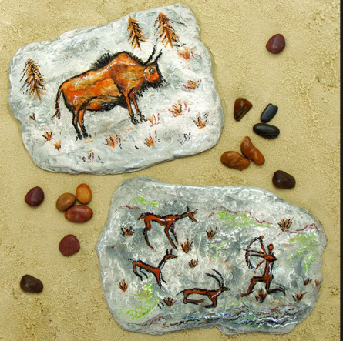
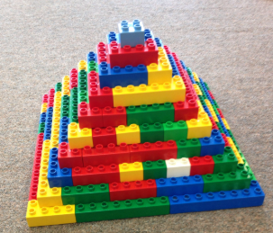
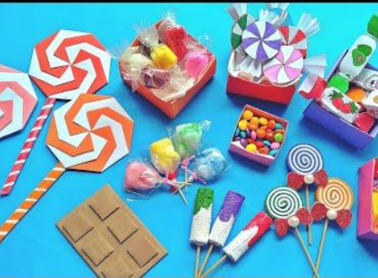
Topic Homework
During the year, there may be a topic that has captured your children’s interest and imagination so we may set some topic based homework for them to complete in their own way/in their own time. We will expect children to be aware of when this is set and if it is required to be completed by a certain date, when it should be bought back to school.

Slide 13
Ideas for helping your child at home
Encourage your child to read every day.
Involve your child in everyday maths opportunities e.g. take your child shopping and talk about the quantities of anything you buy; let your child handle money and work out how much things cost.
Find a quiet place at home to use as a homework area. They will need a flat surface, a good light source, and the right equipment.
Plan a homework timetable and agree on when your child will do their homework.
Discuss any homework tasks with your child and how it connects with what they are studying at school.

Slide 14
How will I know what will my child be learning?
Each half term you will receive an overview of what your child will be learning.
The homework your child brings home is also an indication of what has been taught that week in the class.
Please keep checking your child’s class page on the website as updates are put on half termly.

Slide 15
RSE (Relationship and Sex Education)
Children will study the following learning objectives in RSE in Year 3:
To understand what helps to make people feel happy, how to keep health and make positive lifestyle choices.
To understand what helps us to overcome barriers to reaching health related goals.
Consider touch and to know that a person has the right to say what they like and dislike.
To explore different types of families and who to go to for help and support.
To explore the differences between males and females and to name the body parts using agree words.
In the Summer term and during the year your child will be taught Relationship and Sex Education. This is a spiral curriculum which builds each year and teaches the children the correct terminology to be used via child friendly resources, books and videos.
Further information can be found about what the children will be learning about on our school website RSE page.

Slide 16
Opportunities
In Year 3, PE takes Place on a Wednesday afternoon in the school hall.
Children are to come in their PE Kits. Please note No watches, Jewellery, earrings, etc, for PE.
School PE kits must be worn- not football shirts, other coloured tops, etc.. Remember we are representing St Oswald’s.
In Year 3, pupils will have the opportunity to have focused teaching of a Musical Instrument. This will happen every Wednesday afternoon for a Year.

Slide 17
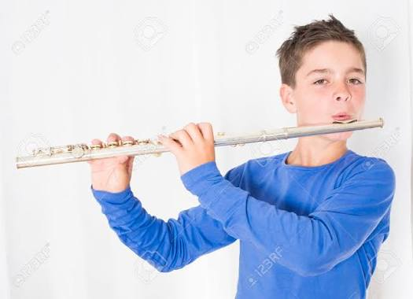
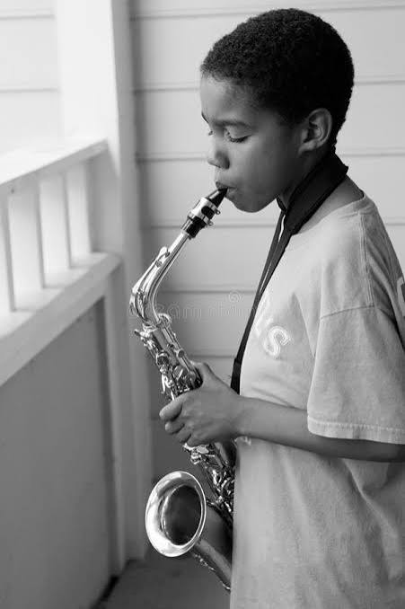
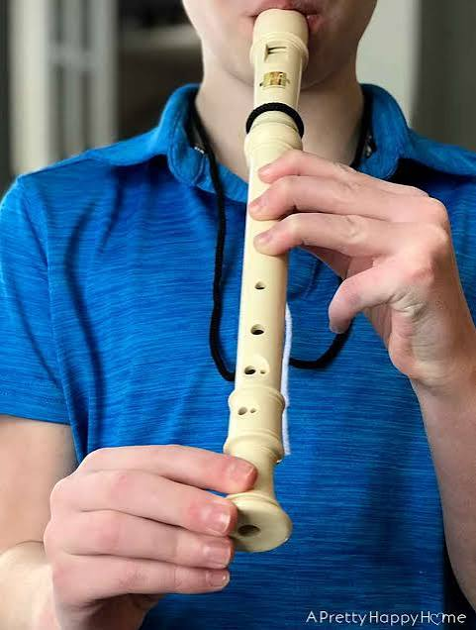
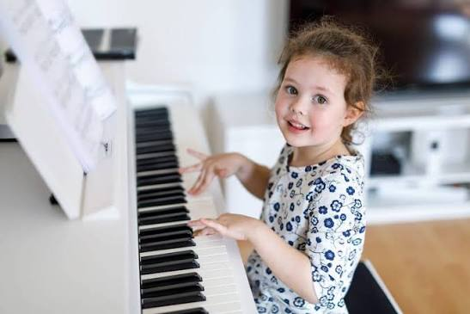
Music at St. Oswald’s.
Every week, each class has a music lesson.
There are extra-curricular activities:
Recorder Club at lunchtime (Y2-Y6- £2/week)
iRock band sessions on Wednesdays during school Y1-Y4 (after-school for Y5/Y6)
instrumental lessons in piano (Contact Grace Secretan on 07931 081886)
and woodwind (Contact Natalie Light on 07860 369816)

Slide 18


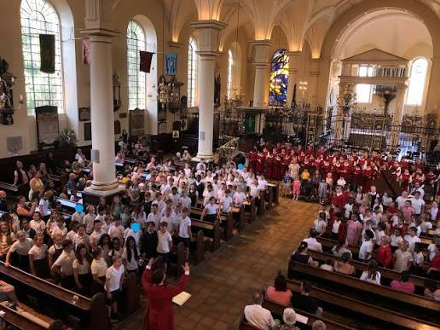
Music in Year Three
This year your child will take part in Derby Cathedral’s Music in Schools programme, launched in September 2021. Since then, they have reached over 2000 children and currently work with 900 children weekly in 17 schools, bringing them a high-quality musical education. Sessions are delivered by one of our team of professional musicians, all of whom are trained choral or keyboard specialists.
Through the whole-class singing sessions element of the programme, we cover many elements of the model music curriculum through practical exploration, following an incremental approach to build skills and knowledge.
Termly performance opportunities are available, including the Celebration Concert, where the pupils will perform alongside the prestigious Cathedral Choir in a concert in the Cathedral.

Slide 19
School day
Door opens at 8.45 and closes at 8.55. Register is 8.55-9am.
If you are late please go to the School Office where Miss Simons will mark you in school
Please ensure your child is punctual as learning starts at 9am.
Attendance at school is crucial to your child’s learning.
Break time;
In Juniors, water bottles are provided for your child. Children can also bring in a healthy snack- as per our policy this is fresh fruit or fresh vegetables. Please note that fruit/vegetables are now not provided for the children under the National Fruit Scheme.
Lunchtime; Meals are now cooked on the school site following the installation of the cooking kitchen. Details and information about school meals will be shared.

Slide 20
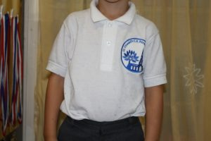
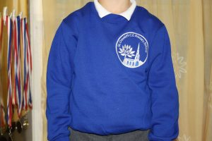
School Uniform
We expect every child to wear the St Oswald’s school uniform. If for any reason you are struggling then we have preloved uniform available in school. Please see Miss Simons.

Slide 21
Essential Sweatcardi (embroidered with the primary school logo) £10.50
Essential Polo Shirt (embroidered with the primary school logo) £6.50
(No Woollen or navy cardigans)
Button Fronted Gingham Dress (embroidered with the primary school logo) £15.00
Fleece Jacket (embroidered with the primary school logo) £13.00
Other items of clothing (this is not able to be purchased in school)
girls to wear grey tights or grey socks/white socks (no patterned tights)
girls to wear GREY skirts, shorts, pinafore dress or trousers (NOT Black or blue)
Boys to wear GREY trousers or shorts (NOT black or blue)
Boys to wear grey socks
Boys to wear leather black school shoes (no canvas shoes or trainers or boots)
Girls to wear black leather/patent shoes (no canvas shoes, trainers or open toed sandals or boots.)
In Infants please can you ensure children have Velcro shoes not laces or buckles

Slide 22
Resources
All resources are provided for your child at St Oswald’s so no pencil cases or equipment is required.
Children will have a school water bottle which will be cleaned and refilled with water daily.
Swimming- You will need to ensure your child has a swimming hat (these can be purchased from the school office)
In PE The junior children will be doing Hockey using wooden hockey sticks. The school will provide children with shin pads but children will need their own Gum shields. Please can you purchase your child’s own gum shield and then this can be kept in school for the duration of this section in PE. This is due to health and safety.

Slide 23
Food Intolerances
We have more and more children in our school who have allergies, some severe requiring them to have epi pens close by.
As a result we ask you to refrain from any nuts as part of snacks.
We also ask that you no longer bring in cakes or treats when there is a birthday due to the range of allergies within each class.

Slide 24
Educational Visits
All visits which we take our children on are linked to the learning that they will be doing in class. They will be focused to enhance the children's knowledge of a topic or piece of learning.
Our Topics this year are:
Autumn 1: Scrumdiddlyumptious.
Cadbury’s World visit- Thursday 1st October 2026.
Autumn 2: Tribal Tales
Spring 1: Pharaohs
Spring 2: Tremors
Summer 1: Mighty Metals
Summer 2: Urban Pioneers
If we cannot go out on a visit then we will have visitors who will come into school.

Slide 25
Thank you for listening.
We operate an open door policy and are always available to support and help your child and you as a family in anyway we possibly can. This could be sign positing for support and advice or meeting to discuss ways in which we as a school can support your child on their educational journey.
All information is shared amongst the team within the class.

